Slide 1
CHAOS Scale-out Graph Processing from Secondary Storage
Amitabha Roy Intel, Santa Clara
Laurent Bindschaedler
Jasmina Malicevic EPFL, Switzerland
Willy Zwaenepoel
Notes:
Thanks! Good morning! It is my pleasure to present to you today the culmination of about 2 years of hard work in collaboration with Amitabha Roy, …

Slide 2

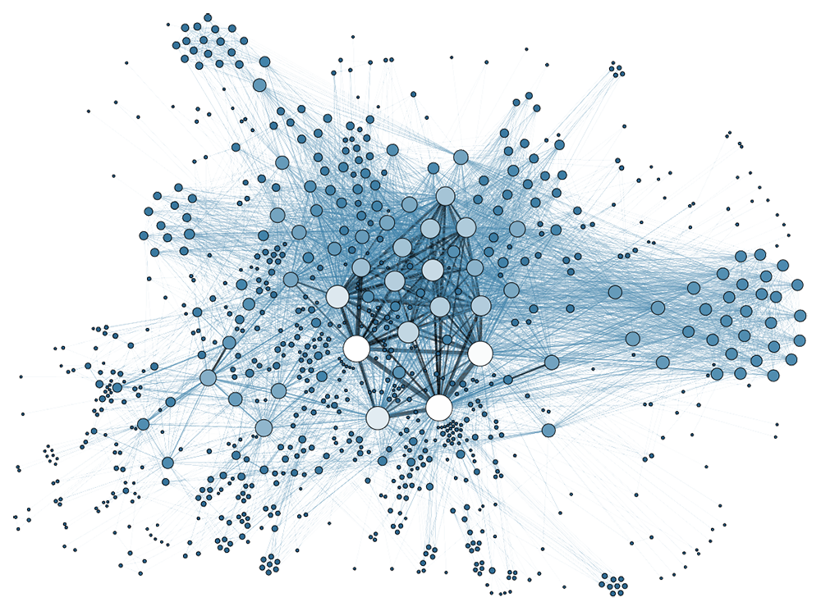

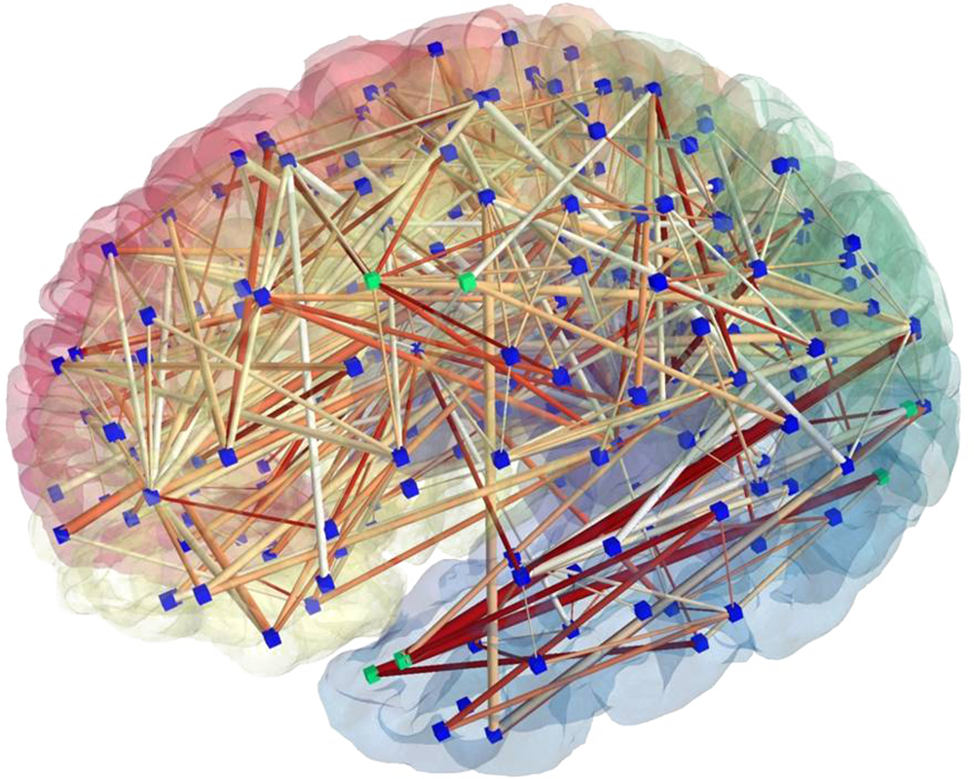
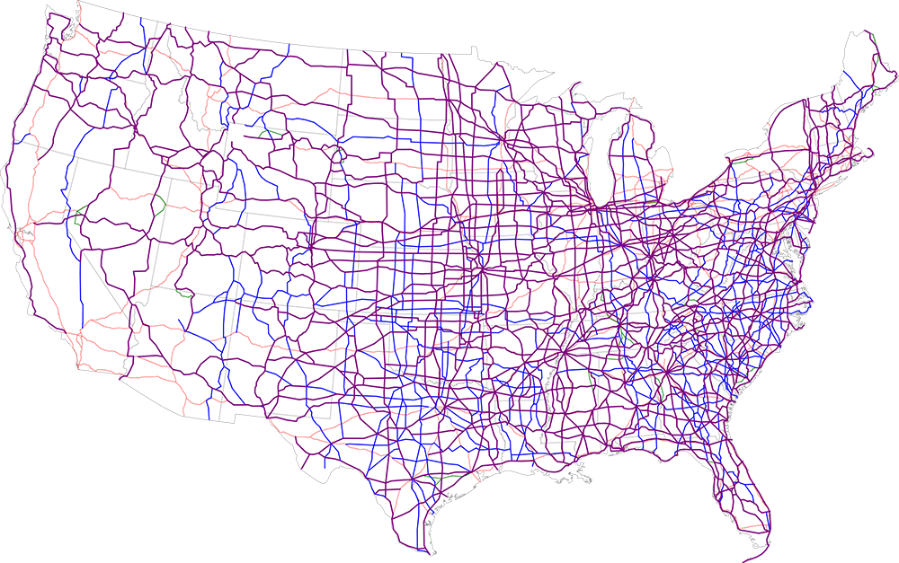
Graphs are everywhere…
Notes:
This talk is about graphs, which are useful in a variety of domains, from … to …
The size of these graphs is ever growing.

Slide 3

What is large?
“
“
A billion edges isn’t cool. You know what’s cool? A TRILLION edges!
– Avery Ching, Facebook
Notes:
How big you may ask? Well, Facebook says we should build systems to process at least a trillion edges (which is what they did with Giraph).

Slide 4
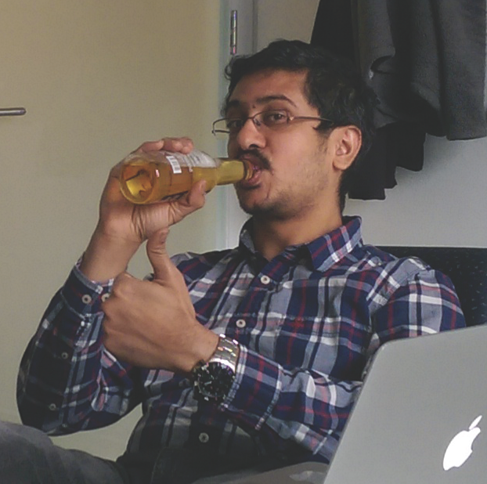
What is large?
“
“
We just did 8 TRILLION edges using only 32 machines…
– Amitabha Roy, EPFL

Slide 5


CHAOS Scale-out Graph Processing from Secondary Storage
+
A few machines
Secondary storage
Notes:
Chaos is the first efficient scale-out graph processing system from storage
Chaos is a capacity play with reasonable performance.

Slide 6
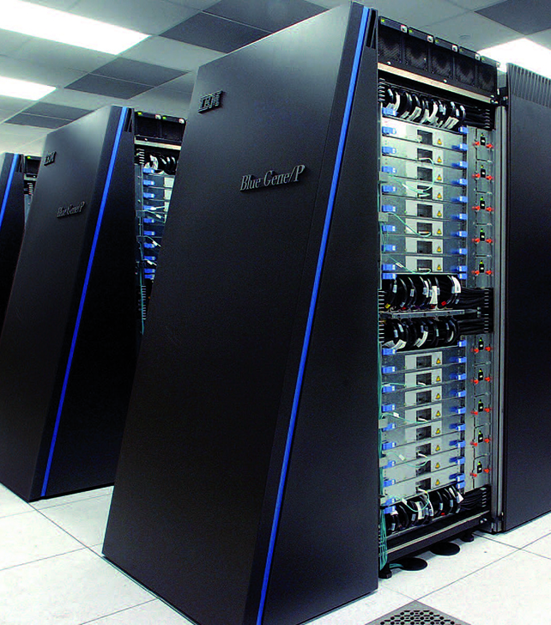
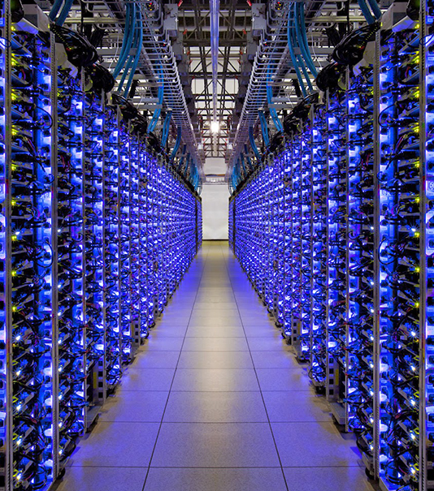
What it used to take to process large graphs
Big Iron
Large Cluster
Notes:
Current approaches throw resources at the problem!

Slide 7


Chaos trades speed for cost
COST
Chaos
Large Cluster
Big Iron
SPEED
Notes:
Chaos trades speed for cost. We don’t actually try to compete with these alternatives on execution time, but we rival them on capacity and cost.

Slide 8
Recipe for Chaos
Edge Centric
Work Stealing
Chaos Storage
Randomization
Randomization
Streaming Partitions
Notes:
Chaos relies on 4 main ingredients which work in synergy.
These principles are not new, but their use in the context of graph processing is. In fact, this is what makes Chaos so effective.
Randomization permeates the whole design

Slide 9
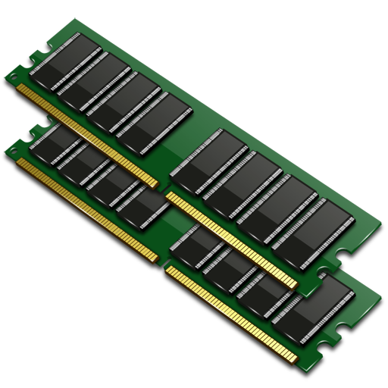
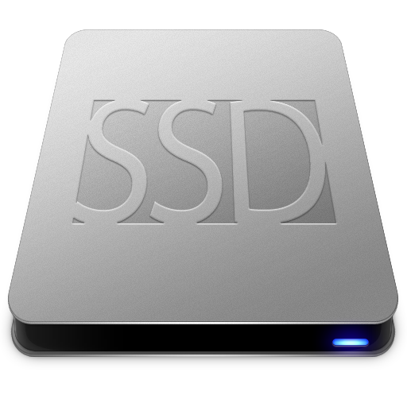
Graph algorithms produce random access
Random access penalties:
1.4X
20X
200X
How can we achieve sequential access to secondary storage?

Slide 10
Starting Point: X-Stream [SOSP’13]
Edge-centric graph processing
Streaming partitions
Vertices in main memory for random access
Edges in secondary storage for sequential access
Reorganize computation to stream edges

Slide 11
Edge-centric Graph Processing
Store state in vertices
Scatter – For all outgoing edges:
new update = f(vertex value)
Gather – For all incoming edges:
vertex value = g(vertex value, update)
Notes:
Gather: for all incoming edges = for all updates

Slide 12
Edge-centric Graph Processing
Store state in vertices
Scatter – For all outgoing edges in ANY ORDER:
new update = f(vertex value)
Gather – For all incoming edges in ANY ORDER:
vertex value = g(vertex value, update)
Notes:
Gather: for all incoming edges = for all updates

Slide 13
Execution on a single machine
V
E
Compute
Storage

Slide 14
Streaming Partitions
V₁
E₁
V₂
…
E₂
V_{n}
…
E_{n}
Notes:
Partition (V’, E’) of graph (V, E) such that
V’ fits in memory of the machine
E’ has all outgoing edges from V’
E’ contains all edges whose source vertex originates in V

Slide 15
Execute partitions one by one
V₁
E₁
V₂
…
E₂
V_{n}
…
E_{n}

Slide 16
Execute partitions one by one
V₁
E₁
V₁
V₂
…
E₂
V_{n}
E₁
…
E_{n}

Slide 17
Execute partitions one by one
V₁
E₁
V₂
V₂
…
E₂
V_{n}
E₂
…
E_{n}
Notes:
Mention that this is the first part of scatter and we’re not discussing writing updates and reading them back in

Slide 18
Scale-out ⇒ Chaos
…
…
Notes:
How do we distribute the graph?

Slide 19
Insight
Edge-centric computation is order-oblivious
⇒ Streaming partitions are independent
⇒ Assign an equal number to each machine

Slide 20
Scaling out to m machines
…
V₁
V₂
V₃
V_{m}
…

Slide 21
Problem: I/O Imbalance
…
V₁
V₂
V₃
V_{m}
E₁
E₂
E₃
…
E_{m}
Notes:
Especially if the graph has a power-law degree distribution

Slide 22
Insight
For secondary storage in a small cluster:
Remote bandwidth ~ local bandwidth
(Flat Storage [OSDI’12])
⇒ Locality hardly matters
⇒ Stripe data to achieve I/O balance

Slide 23
Solution: Stripe edges
…
V₁
V₂
V₃
V_{m}
E_{1,2}
E_{1,4}
E_{1,7}
E_{1,3}
E_{1,5}
E_{1,1}
E_{1,6}
E_{2,13}
E_{2,3}
E_{2,7}
E_{2,12}
E_{2,9}
E_{2,11}
E_{2,6}
E_{2,8}
E_{2,10}
…
E_{2,2}
…
E_{3,2}
E_{2,1}
…
E_{2,14}
E_{2,4}
…
E_{3,1}
E_{2,5}
…
E_{3,3}
E_{m,1}
E_{m,2}
E_{m,4}
E_{m,5}
E_{m,6}
E_{m,3}
Notes:
(This is similar to RAID with two big differences:
We do not keep any metadata about where each stripe is.
We have no concept of reading stripes sequentially.)

Slide 24
Where do we read the next edge stripe?
V₁
…
?
?
?
?
…
E_{1,2}
E_{1,4}
E_{1,7}
E_{1,3}
E_{1,5}
E_{1,1}
E_{1,6}
Notes:
This is for scatter. Gather is similar.

Slide 25
Insight
For scatter and gather:
Order does not matter
⇒ Pick any edge/update stripe

Slide 26
Answer: Any random stripe that has not been read!
V₁
…
E_{1,3}
…
E_{1,2}
E_{1,4}
E_{1,7}
E_{1,5}
E_{1,1}
E_{1,6}

Slide 27
In fact, we read several stripes…
V₁
…
E_{1,4}
E_{1,1}
E_{1,6}
…
E_{1,2}
E_{1,7}
E_{1,5}
Notes:
We do this to maintain high disk utilization. More details in the paper.
Exploit power of choices
Mitzenmacher & Sparrow paper

Slide 28

Chaos achieves I/O balance
I/O Imbalance
Notes:
I hope I convinced you that Chaos achieves … through a kind of “flat” storage approach.

Slide 29
Problem: Computation Imbalance
…
V₁
V₂
V₃
V₃
V_{m}
E_{1,2}
E_{1,4}
E_{1,7}
E_{1,3}
E_{1,5}
E_{1,1}
E_{1,6}
E_{2,13}
E_{2,3}
E_{2,7}
E_{2,12}
E_{2,9}
E_{2,11}
E_{2,6}
E_{2,8}
E_{2,10}
…
E_{2,2}
…
E_{3,2}
…
…
…
E_{3,2}
E_{2,1}
E_{2,14}
E_{2,4}
E_{3,1}
E_{3,1}
E_{2,5}
E_{3,3}
E_{3,3}
E_{m,1}
E_{m,2}
E_{m,4}
E_{m,5}
E_{m,6}
E_{m,3}

Slide 30
Insight
Edge/update stripes are independent
⇒ Any machine can process them
⇒ Use work stealing to achieve computation balance

Slide 31
Stealing: Randomly select a target machine
I’m done. Need help?
V_{i}
Yes!
No, overhead too high!
Notes:
In a nutshell, the heuristic to decide whether to steal or not is to estimate the overhead and say no if it’s too high.

Slide 32
Stealing: Copy vertex state
V₁
V₁
…
…
E_{1,2}
E_{1,7}
E_{1,5}

Slide 33
Work Stealing Issue?
Multiple machines can work on the same streaming partition
Multiple machines access the edges/updates simultaneously
Synchronization problem?!?
!

Slide 34
Stealing: Which edge stripe do we read?
V₁
V₁
…
?
?
?
?
…
E_{1,2}
E_{1,7}
E_{1,5}

Slide 35
Insight
For scatter and gather:
Order does not matter
⇒ No need for explicit division of work
⇒ Multiple machines can work on the same partition simultaneously

Slide 36
Answer: Any random stripe that has not been read!
V₁
V₁
…
E_{1,2}
…
E_{1,7}
E_{1,5}

Slide 37
Consequence of Work Stealing
Multiple machines have partial vertex states
Gather phase needs to reconcile them
Apply – For each partial vertex state:
vertex value = f(vertex value, partial state)
Modified Gather Apply Scatter (PowerGraph [OSDI’12])

Slide 38
Chaos achieves compute balance
Compute Imbalance
Notes:
I hope I convinced you that Chaos achieves … through work stealing

Slide 39
Recipe for Chaos
Edge Centric
Work Stealing
Chaos Storage
Randomization
Randomization
Streaming Partitions
Notes:
You should now have a feel for how these 4 principles interact together in synergy to help us build Chaos.

Slide 40


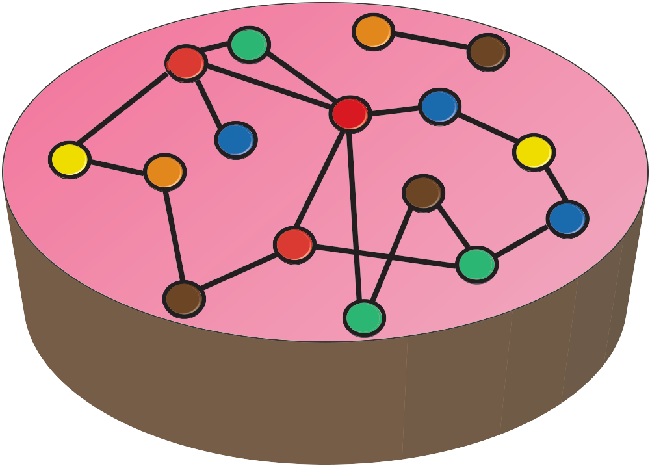

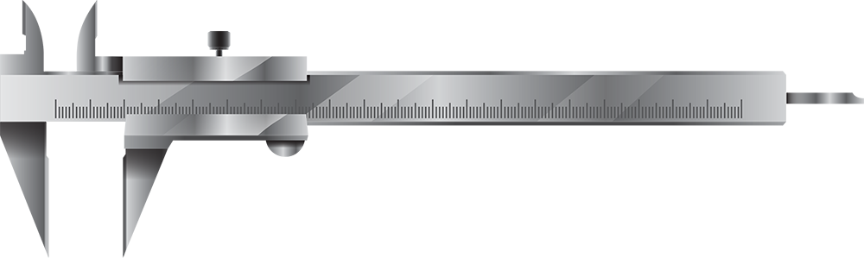
Partitioning for Locality and Load Balance
Edge cuts
Pregel [SIGMOD’10]
Giraph [HADOOP’11]
Vertex cuts
PowerGraph [OSDI’12]
Sorting & sharding
GraphChi [OSDI’12]
Hilbert curve
Naiad [SOSP’13]
Notes:
Related work – Common wisdom is to partition for locality and load balance => Expensive preprocessing.
We dubbed this approach “Order” and we oppose it to “Chaos”.

Slide 41

Chaos vs. Order
Static Partitioning
Locality
Load balance
Chaos
Flat storage
Dynamic load balance
Notes:
We don’t wanna sort. We don’t wanna do any complex pre-preprocessing. We just wanna get the raw data and start computing with it right away.

Slide 42

Evaluation
32 16-core machines (one rack)
32GB RAM, 480GB SSD, 2x6TB HDD
Full-bisection bandwidth 40GigE switch
RMAT-generated graphs
Wall-clock times (incl. preprocessing)
Notes:
Wall-clock times from raw edge list on disk to final vertex state

Slide 43

Benchmarks
Collaborative Filtering
ALS
Graph Statistics
HyperANF,
Centralities
Chaos
SpMV and
variants
Traversal
BFS, SSSP
Structure Mining
(W)CC, MIS, MCST, Triangle Counting
Machine Learning
PageRank, BP,
Cond .
Notes:
We selected a relevant subset of 10 algorithms for the evaluation.

Slide 44
Runtime Comparison (out-of-core systems)
System | BFS Runtime (RMAT-27) | Machines
Giraph [HADOOP’11] | 1 hour 40 minutes* | 32
Graphchi [OSDI’12] | 27 minutes | 1
X-Stream [SOSP’13] | 8 minutes | 1
Chaos [SOSP’15] | 35 seconds | 32
* Out-of-core Giraph
Notes:
Most of the results I will show later on are normalized.
I want to show you some absolute runtimes to give you a feel that Chaos is in the right ballpark by comparing it to various out-of-core graph processing systems. Its single machine runtime is similar to that of X-Stream and because it’s a system designed with disks in mind, it’s actually a lot faster than the out-of-core Giraph extension.
Let’s now jump into the detailed experiment.

Slide 45
Weak Scaling Experiment
Double number of machines
Double input size (edges and vertices)
Result is normalized runtime to m=1 (slowdown)
Notes:
Start with one machine and a given input size, at every step...

Slide 46
Weak Scaling Results
2.29X
Lower = Better
1.61X
0.97X
Input size doubles when number of machines doubles

Slide 47
Strong Scaling Experiment
Double number of machines
Fix input size (RMAT-27)
Result is speedup relative to m=1
Notes:
Fix the input size. Start with one machine and double each time

Slide 48
Strong Scaling Results
Higher = Better
13X
Double number of machines, but keep input size fixed

Slide 49
Why does it scale well?
Chaos runs constantly at near-maximum I/O bandwidth
Notes:
The bandwidth increases proportionally to the number of machines or disks in the system

Slide 50
Why does it not scale perfectly?
Work stealing introduces overhead
Overhead is algorithm and input dependent

Slide 51
No Work Stealing
Notes:
Without work stealing, you can clearly see that some machines have a lot more work than others. That means the faster machines would have to wait on the slower machines. This is bad. We want to somehow flatten this.

Slide 52
With Work Stealing
Notes:
And this is what happens with work stealing. The extra work on the few very loaded machines is picked up by the less loaded machines and is kinda spread out nicely across all machines. You can see that all the machines now finish roughly at the same time.

Slide 53
With Work Stealing
Notes:
And this is what happens with work stealing. The extra work on the few very loaded machines is picked up by the less loaded machines and is kinda spread out nicely across all machines. You can see that all the machines now finish roughly at the same time.

Slide 54
Capacity Results
Input: 128TB
I/O: 1.75PB
Input: 16TB
I/O: 218TB

Slide 55
Additional Results in Paper
Bottleneck analysis
Features evaluation
Comparison to other systems

Slide 56

Graph500 – Top 10 July 2015
Rank | Size | Machine | Location | Nodes | Cores
1 | 32T | BlueGene/Q | Lawrence Livermore | 98304 | 1572864
2 | 16T | BlueGene/Q | Argonne | 49152 | 786432
3 | 16T | Cray CS300 | Lawrence Livermore | 300 | 7200
4 | 16T | K (Fujitsu Custom) | RIKEN AICS | 82944 | 663552
5 | 4T | PRIMEHPC FX10 | University of Tokyo | 4800 | 76800
6 | 4T | BlueGene/Q | FZJ | 16384 | 262144
7 | 4T | PRIMEHPC FX10 | University of Tokyo | 4800 | 76800
8 | 2T | T-Platforms - MPP | Moscow University | 4096 | 32768
9 | 2T | BlueGene/P | FZJ | 16000 | 64000
10 | 2T | T-Platforms - MPP | Moscow University | 4096 | 8192
Notes:
This is a ranking with almost 200 contenders. We sort the benchmark by capacity, but it can also be sorted by execution speed.

Slide 57
Chaos – #5 in Capacity Ranking?
Rank | Size | Machine | Location | Nodes | Cores
1 | 32T | BlueGene/Q | Lawrence Livermore | 98304 | 1572864
2 | 16T | BlueGene/Q | Argonne | 49152 | 786432
3 | 16T | Cray CS300 | Lawrence Livermore | 300 | 7200
4 | 16T | K (Fujitsu Custom) | RIKEN AICS | 82944 | 663552
5 | 8T | T-Rex (Xeon E5) | EPFL, Switzerland | 32 | 512
6 | 4T | PRIMEHPC FX10 | University of Tokyo | 4800 | 76800
7 | 4T | BlueGene/Q | FZJ | 16384 | 262144
8 | 4T | PRIMEHPC FX10 | University of Tokyo | 4800 | 76800
9 | 2T | T-Platforms - MPP | Moscow University | 4096 | 32768
10 | 2T | BlueGene/P | FZJ | 16000 | 64000
Notes:
Caution: We make no claim about how fast we can process the input compared to others! Clearly, they are much faster…

Slide 58
Conclusion
Edge Centric
Work Stealing
Chaos Storage
Randomization
Randomization
Streaming Partitions
Notes:
I described the 4 key design principles in Chaos: …
And hopefully I’ve given you a feel for how these interact together and how randomization ties everything together nicely.

Slide 59
Conclusion
Chaos processes large graphs on small clusters
Chaos uses secondary storage
Chaos scales linearly with the available storage
Chaos breaks the terascale barrier
8 trillion-edge graph on 32 machines

Slide 60


CHAOS Scale-out Graph Processing from Secondary Storage
https://github.com/labos-epfl/chaos
http://labos.epfl.ch/

Slide 62
Backup Slides

Slide 63
Where do we write the update stripe?
V₁
…
U₁
?
?
?
?
…

Slide 64
Answer: choose any device at random
V₁
…
U₁
…

Slide 65



Chaos – Summary
COMPUTATION BALANCE
I/O BALANCE
SEQUENTIALITY
X-Stream
Edge-centric
Streaming partitions
Flat storage Randomization
Chaos
Work stealing Randomization
No expensive partitioning and no I/O synchronization!

Slide 66

Results Overview
1.61X Average Slowdown from 1 machine to 32 (weak scaling)
13X Average Speedup with 32 machines (strong scaling)
19 hours to run 5 iterations of PageRank on a graph with 1T edges
9 hours to solve BFS on a graph with 1T edges

Slide 67



Are there any scaling limitations?
Network
Bottleneck resource
Performance suffers if network < storage Full-bisection bandwidth necessary
Storage
Bottleneck resource
Unrealized performance (waste) if storage < network
Compute
Low impact
Possible minor impact on performance in some applications (e.g., FPU intensive)

Slide 68
Is work stealing optimal?
More imbalance
Lower = Better
More overhead

Slide 69
Chaos vs Giraph
128X
Lower = Better
1.5X

Slide 70
Disk bandwidth < Network throughput
Possible network bottlenecks
NIC
Switch backplane
Generally not a problem for small clusters
Can build a CLOS network
Notes:
If the interface of a single machine is the bottleneck, you can add more NICs.
If full bisection bandwidth is not possible, you can get it (up to datacenter scale) by building a CLOS network. FDS storage paper and VL2 showed that.

Slide 71
Metadata
Chaos only does structure mining
Usage
Graph + metadata ⇒ Graph structure ⇒ Chaos
Vertex state is sorted, can join later
Supporting inline metadata is ongoing work

Slide 72
Fault Tolerance
Chaos does Bulk Synchronous Processing
Co-ordinated snapshot of vertex state between iterations
Low overhead since most state on disk
6% for a graph problem with 218TB of I/O
Tackles machine failure, but not disk failure
Replication is future work

Slide 73
Where are the real world graphs?
Common crawl dataset https://commoncrawl.org
Facebook https://www.facebook.com/notes/facebook-engineering/scaling-apache-giraph-to-a-trillion-edges/10151617006153920
Florida sparse matrix dataset http://www.cise.ufl.edu/research/sparse/matrices/
PRISM program

Slide 74

What about COST?
Configuration that Outperforms a Single Thread
Chaos on 8T edges: 104 hours
Frank McSherry’s laptop on 8T edges:
Jan 1 2015
SOSP 2015
SOSP 2025
Start BFS
End
1%

